Slide 1
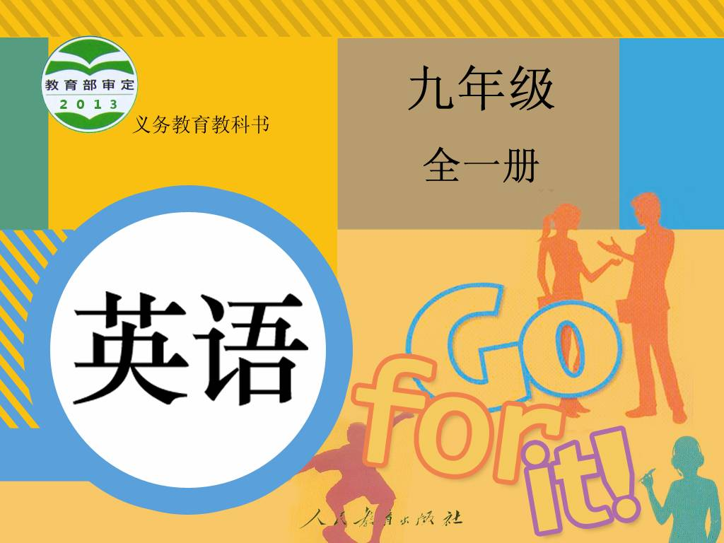
Unit 13

Slide 2
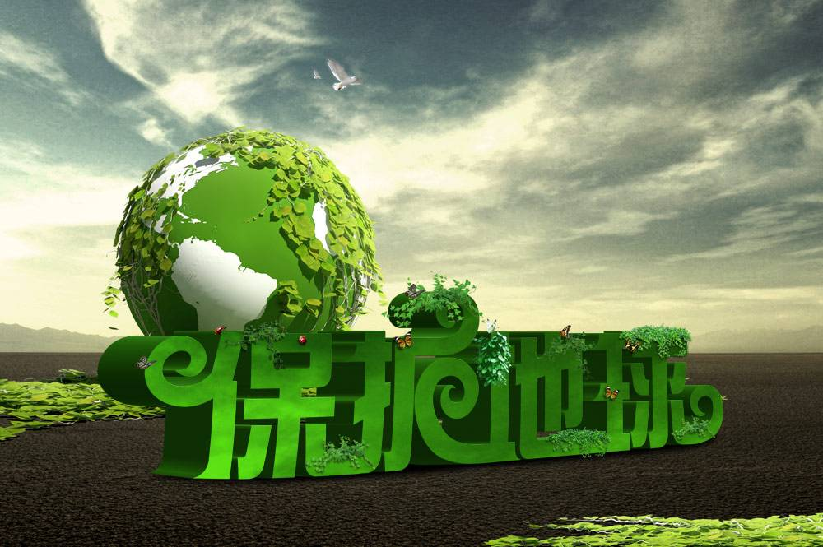
Unit 13
We're trying to save the earth!

Slide 3
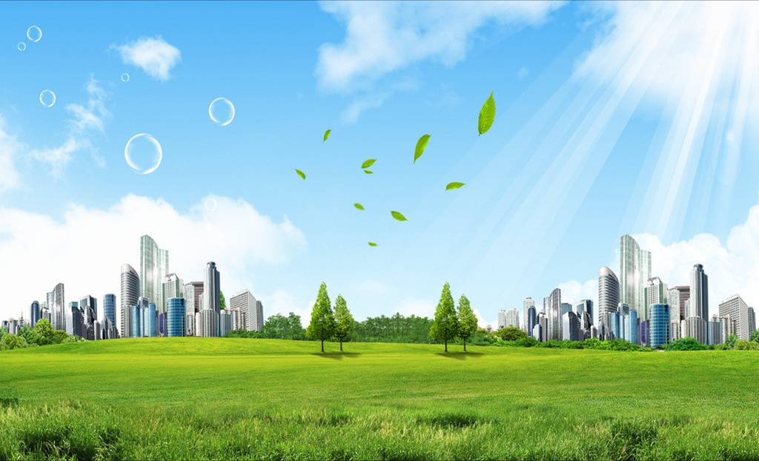


Slide 4


1. To understand the passage about recycling.
2. To have awareness of waste recycling in our daily life.
3. To learn some words and expressions.

Slide 5


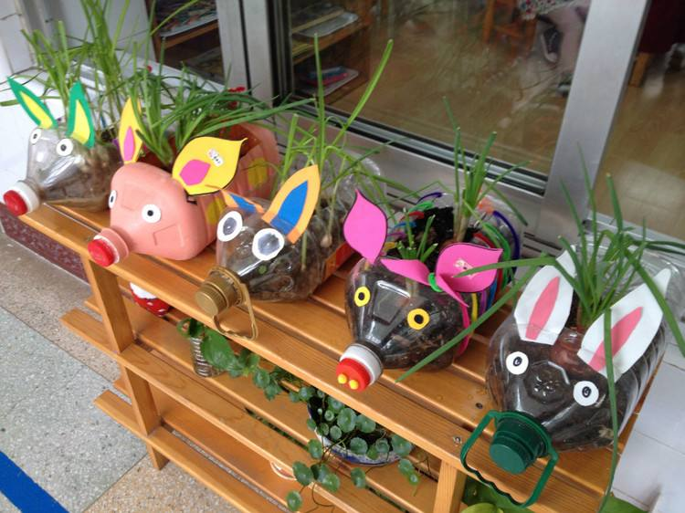
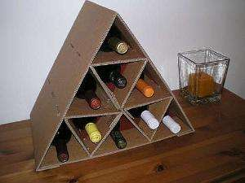
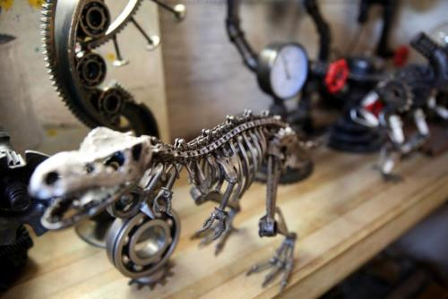
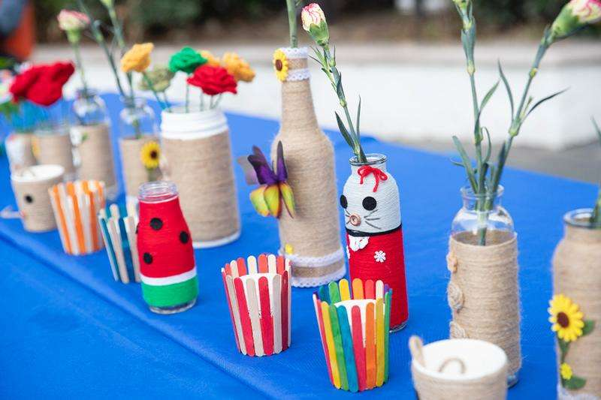
What are they made of?

Slide 6
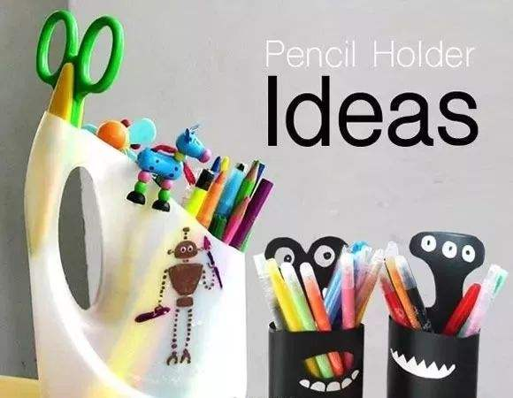
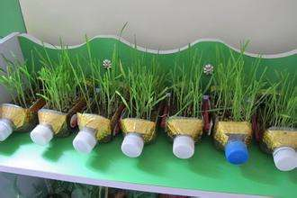
What can we do with a plastic bottle?
grow flowers
pencil holders

Slide 7
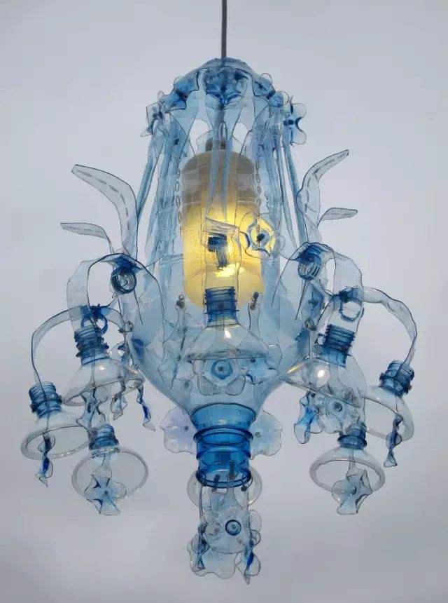
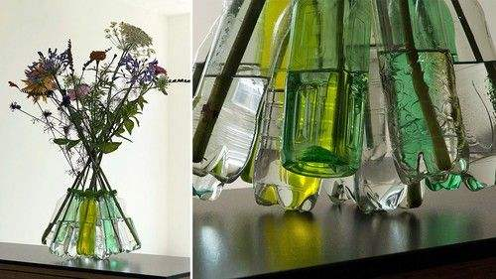
a flower vase
art works

Slide 8


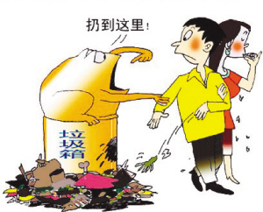
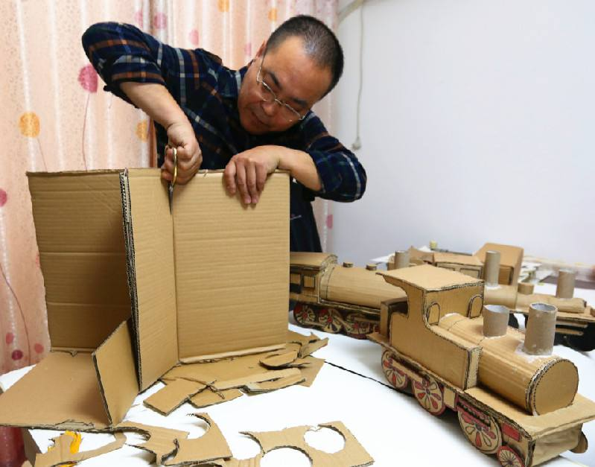
How do you deal with things you don’t use?
Turn waste into “wealth”?
throw them away?

Slide 9
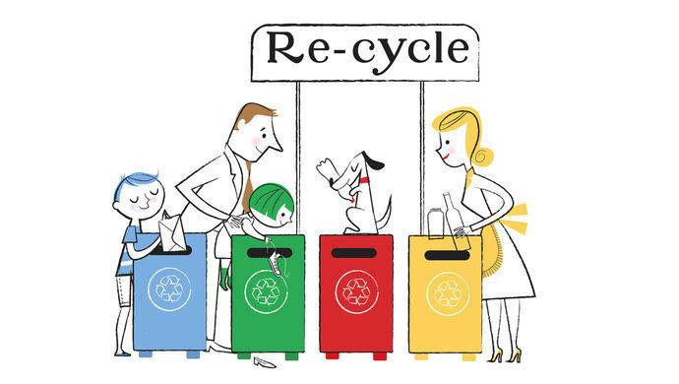
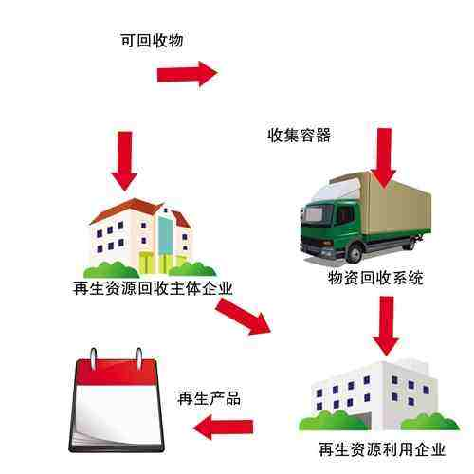
recycle=use again

Slide 10


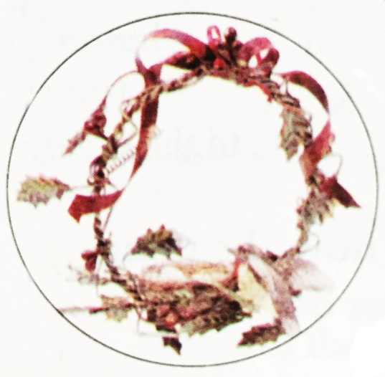
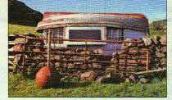
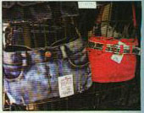
2a
Look at the title and the pictures in 2b. Can you guess what the passage is about?
It is about how people can think of creative ways to use things that are no longer wanted.

Slide 11

Read the passage quickly to find the answer.
How many people are mentioned in the passage? Who are they?
Three. They are Amy Hayes, Jessica Wong,
and Wang Tao.

Slide 12
Find the main idea of each paragraph.
A. Bags made from clothes
B. Art pieces made of iron and other materials from old cars
C. House built of rubbish
Para. 2
Para. 3
Para. 4

Slide 13
2b
Complete the chart below.
Names | What materials did they use? | What did they make?
windows and doors of old buildings that have been pulled down; an old boat; rocks; old glass bottles
Amy
Hayes
a house
Jessica Wong
old clothes, especially old jeans
bags
Wang Tao
iron (n. 铁) and other materials from old cars
beautiful art pieces

Slide 14

Read paragraph 2 and find the answers.
1. Amy recently won a prize from ______________________________.
2. Translate the sentence “she lives
in a house in the UK that she built
herself out of rubbish” mean?
the Help Save Our Planet Society
她住在英国的一所房子里，那是她自己用废弃物建造的。

Slide 15
3. Where do the windows and doors come from?
4. What is top of the house?
5. What is the gate made of?
The windows and doors come from old buildings around her town that were pulled down.
The top of the house is an old boat turned upside down.
The gate is made of rocks and old glass bottles.

Slide 16
Read paragraph 3 and answer the questions.
Is Jessica Wong good at recycling?
What does she do?
2. Where can we buy her bags?
3. What will she write in her book?
Yes, she is. She uses old clothes that people don’t wear anymore to make bags.
In her small shop or website.
New ways to use old clothes.

Slide 17
Read paragraph 4 and complete the blanks.
Wang Tao He makes beautiful art pieces with iron and other materials from _________. He hopes to set up a “metal art” theme park.
old cars

Slide 18
Translate the sentence “Not only can the art bring happiness to others, but it also shows that even cold, hard iron can be brought back to life with a little creativity.”
艺术不但可以给人们带来快乐，而且也说明只需要一点创造力，即使是冰冷、坚硬的铁也可产生活力。

Slide 19


2c
Fill in the blanks with the correct
forms of the phrases in the box.
put to good use build…out of pull down set up known for not only… but also
Amy Hayes lives in the UK. Many of
the old buildings in her neighborhood
were ____________.
pulled down

Slide 20
put to good use build… out of pull down set up known for not only… but also
2. All the rubbish and old things in
Amy’s neighborhood were then _____
__________ when Amy built her house.
3. Amy is very creative. She _______ her front gate ________ rocks and old glass bottles. She put an old boat on top of her house.
put
to good use
built
out of

Slide 21
put to good use build… out of pull down set up known for not only… but also
4. Jessica Wong sells her bags in a small
shop, but she has also _______ an online
business to sell them.
5. Though Jessica’s bags are made from old
clothes, her bags are ___________ being
cute and useful.
set up
known for

Slide 22
put to good use build… out of pull down （拆下） set up known for not only… but also
6. Wang Tao _________ makes large
pieces of metal art that look like
animals or humans, __________
makes smaller pieces for the home.
not only
but also

Slide 23
2d
Underline the words in the passage based on the words below. What are the differences?
think use environment usual recycle build create special recent important protect inspire

Slide 24
think – special –
use – recent –
usual –
environment –
recycle –
important –
build – protect –
create –
inspire –
rethink
especially
reuse, useful
recently
unusual
environmental
recycling
importance
building
protection
creative; creativity
inspiration

Slide 25
1. Rethink, Reuse, Recycle!
re-是最常用的前缀之一。它可以加在名词或动词前面，构成新的名词或动词。re-表示以下意义：
1) 表示“回”或“向后”的意思。
e.g. return（回来）
recall（回忆，召回）

Slide 26
2) 表示“再”、“重新”、“重复”的意思。
e.g. rethink（再思考）
reuse（再运用）
restart（重新开始）
recycle（再利用）

Slide 27
2. She is a most unusual woman.
un-前缀“不，非” ，加在形容词之前，表示否定。
e.g. uncomfortable 不舒服的
unpleasant 不愉快的
unfortunate 不幸的
unfriendly 不友好的

Slide 28
3. Nothing is a waste if you have a
creative mind.
-ive是形容词后缀, 一般表示“有......的”。
create﹢-ive creative
4. Amy recently won a prize from the
Help Save Our Planet Society.
-ly形容词或副词后缀
e.g. really usually, finally, friendly

Slide 29
5. Amy is an inspiration (n.灵感) to us all.
-tion名词后缀，表示动作、状态。
e.g. invitation, attraction, population,
pronunciation
6. She especially likes to use old jeans to
make handbags.
special和especial是同义词，
especially是especial的副词。

Slide 30
7. The theme park to show people the
importance of environmental
protection.
importance是important的名词。
environmental是environment的形容词。
protect﹢-ion protection

Slide 31
Fill in the blanks with the correct forms of the words.
recycle create inspire use usual
unusual
1. It was really _________ for him to stay silent
for a day. He’s such an active boy.
2. The president thought Amy was an
__________ to us all.
3. A theme park will be set up to show people
the importance of ________ (循环利用).
inspiration
recycling

Slide 32
recycle create inspire use usual
4. Think ________, and you can bring the cold
iron back to life.
5. Don’t throw the bottle away. ______ it so
that it can be put to good use.
creatively
Reuse

Slide 33
Make a list of things that need to be
done to save the environment. Which things can be done by common people every day? Which things have to be done by governments and organizations? Discuss these with your group.
2e
take your own bags when you go shopping spend less time in the shower turn off the lights when you leave a room take public transport rather than ride in cars reduce using air conditioners

Slide 34
educate the public ensure that factories get rid of waste in a responsible way preserve the forests preserve endangered species not allow activities that seriously endanger the environment

Slide 35


扔掉；抛弃
好好利用某物
拥有创意的头脑
用……建造……
拆下；摧毁
上下颠倒；倒转
在……前面
获奖
开一家小店
建立网站
在网上出售……
throw away
put sth. to good use
have a creative mind
build ... out of ...
pull ... down
upside down
in front of ...
win a prize
open a small shop
set up a website
sell ... online

Slide 36


Ⅰ. 根据语境选择方框内恰当的单词填空。
1. Man discovered iron. It is a very useful _________.
2. —What do you think of the writer's
_________?
—They are beautiful to read, but they are
hard to understand.
gate, metal, bottle, work, president
metal
works

Slide 37
gate, metal, bottle, work, president
3. Although her father is the ________ of the company, she is going to get the job on her own.
4. There is a man standing at the ________ of our school. It seems that he is waiting for someone.
5. Mandy was very thirsty, so she took a ________ of water from the fridge and drank it.
president
gate
bottle

Slide 38
Ⅱ. 根据意思及提示，翻译下列句子。
1. 这所房子是用垃圾建成的。(build ... out of ...)
2. 她因唱流行歌曲而闻名。(be known for)
3. 你应该停止练习吉他，休息一会儿。(stop)
This house was built out of rubbish.
She is known for singing pop songs.
You should stop practicing the guitar and have a rest.

Slide 39
4. 老师经常告诉我们要好好利用周末。 (put ... to good use)
5. 上周保罗(Paul)扔掉了旧自行车，然后买了一辆新的。 (throw away)
The teacher often tells us to put our weekend to good use.
Paul threw away the old bike and bought a new one last week.

Slide 40
6. 爸爸以前常去的那家饭店去年被拆除了。(pull ... down)
7. 莫莉(Molly)在乡下的居住使她恢复了健康。 (bring ... back to ...)
The restaurant my father used to go to was pulled down last year.
Molly’s stay in the countryside brought her back to health.

Slide 41


1. Survey the students in your class.
Do you… | Names
recycle paper?
turn off lights in the house?
…
2. Make something out of rubbish by
yourself.

Slide 42
